Slide 1
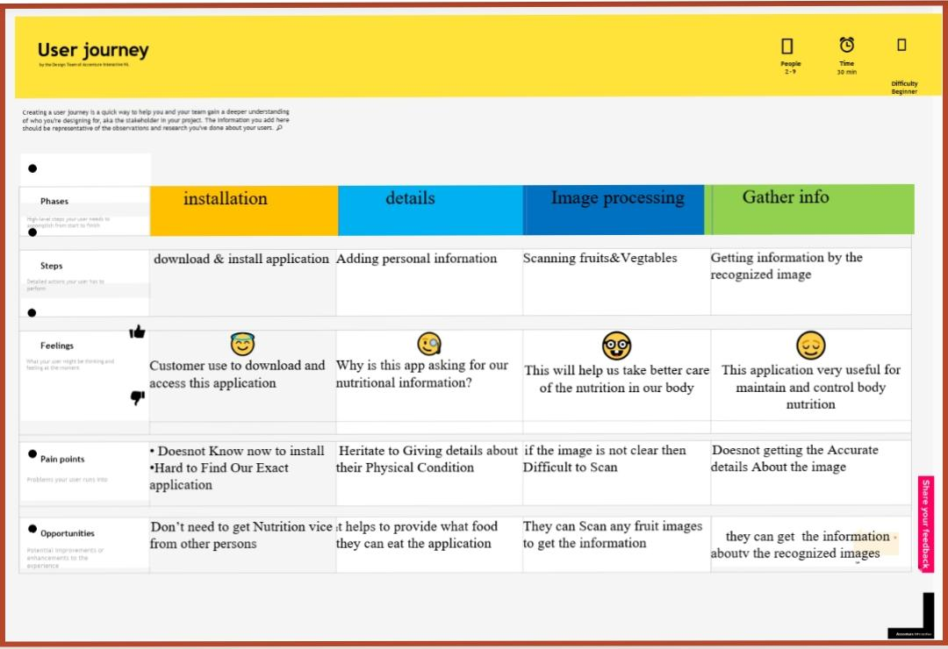
Project Design Phase-II Customer Journey Map
Date | 08 October 2022
Team ID | PNT2022TMID49469
Team Leader | Mr. Mugeshkumar M(923819104026)
Team Member | Mr. Manikandanprabhu M (923819104024), Mr. Arun O(923819104006), Mr.Aravidh (923819104301).
Project Name | AI-Powered Nutrition Analyzer For Fitness Enthusiasts
Maximum Marks | 2 Marks

